Slide 1
CRIME ANALYSIS USING STATISTICAL MODELING TECHNIQUES
Yao Li
Camille Floyd
Fidencio Loza

Slide 2
PROJECT SCOPE
Data Collection: Gather crime data from the FBI's Uniform Crime Reporting (UCR) program. Obtain demographic data, such as population and income data, from the U.S. Census Bureau. Collect weather data from OpenWeather API.
Data Preprocessing and Cleaning: Clean, preprocess, and merge the datasets using Python-based scripts to prepare them for analysis. Handle any missing or inconsistent data and ensure the final dataset is ready for statistical modeling.
Data Analysis: Analyze the relationships between crime rates and various demographic and weather-related factors using statistical modeling techniques, such as linear regression, time series analysis, and clustering. Identify the key factors that contribute to the variation in crime rates, such as population density, poverty rates, temperature, and precipitation.
Visualization and Communication: Create informative visualizations, such as maps, charts, and graphs, to communicate the findings and insights from the data analysis. Write a comprehensive report that summarizes the methodology, findings, limitations, and recommendations of the project.

Slide 3
PROJECT DELIVERABLES
• Cleaned and merged dataset that includes crime, demographic, and weather-related data.
• Statistical models that capture the relationships between crime rates and demographic and weather-related factors.
• Informative visualizations that communicate the findings and insights from the data analysis.
• A comprehensive report that summarizes the methodology, findings, limitations, and recommendations of the project.

Slide 4
REPORT: ANALYSIS OF CRIME AND WEATHER DATA
• Goal: Identify patterns or correlations between weather conditions and crime rates in Salt Lake City.
• Two datasets used: crime data from the FBI's UCR program and weather data from the OpenWeather API.
• Analysis includes loading, cleaning, merging datasets, and creating four visualizations.
Methodology
• Python programming language and several libraries used, such as pandas, seaborn, matplotlib, and statsmodels.
• Datasets cleaned by converting the date column to datetime format.
• Two datasets merged on the "Incident_Date" column.
• Four visualizations created to help understand the data better.

Slide 5
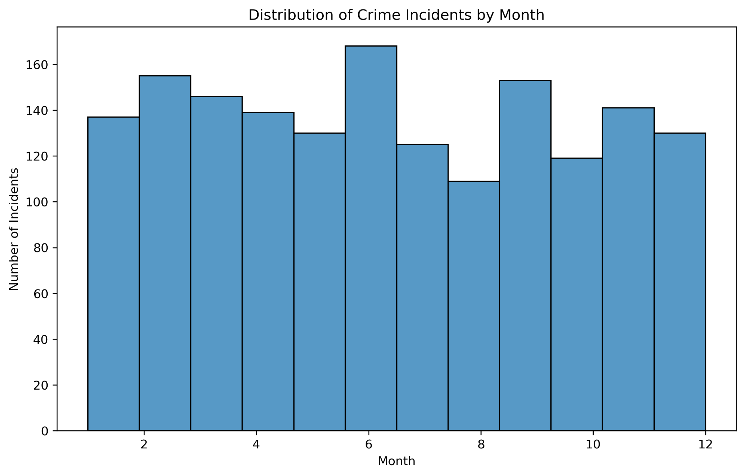
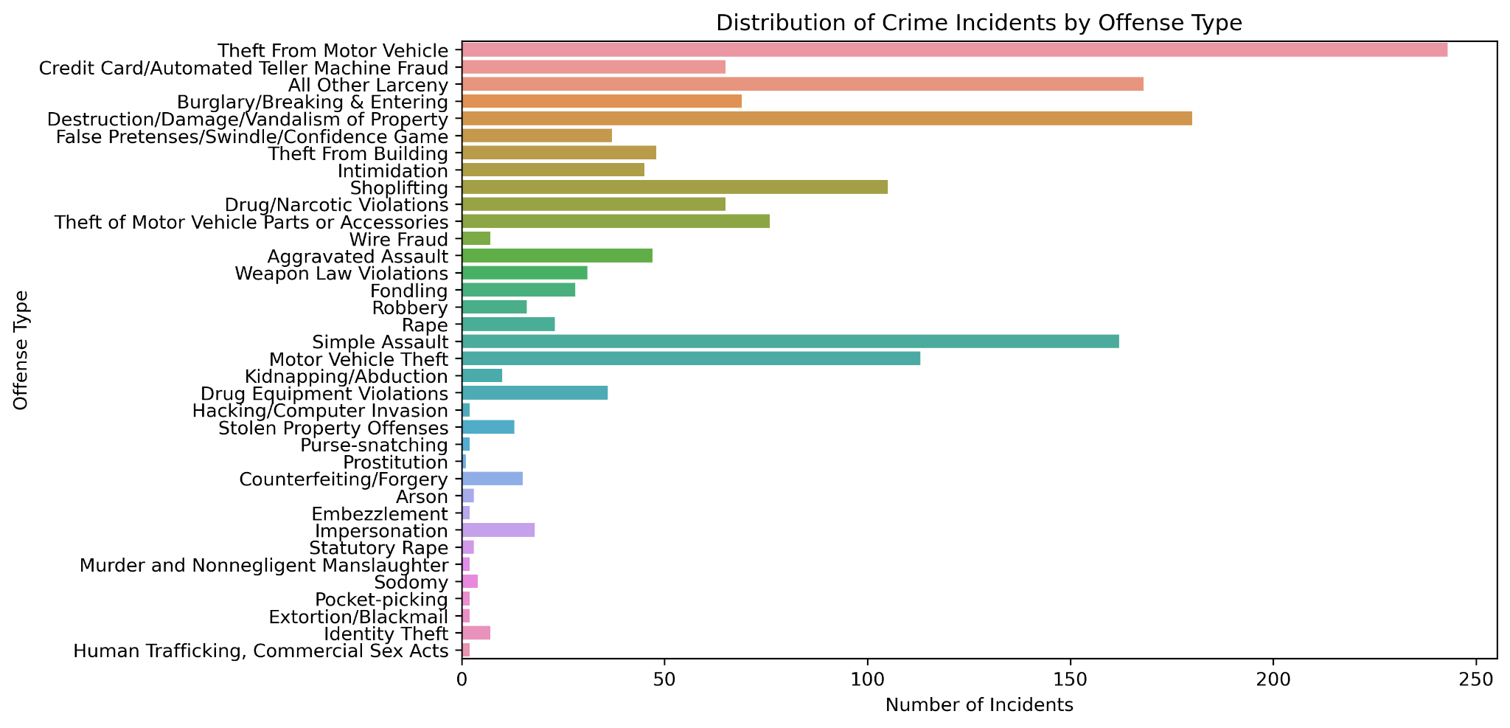
FINDINGS
• Distribution of crime incidents by month showed that crime incidents were highest during the summer months and lowest during the winter months.
• Distribution of crime incidents by offense type showed that heft-related offenses such as theft from motor vehicles, theft from buildings, and shoplifting are more common in Salt Lake City.

Slide 6
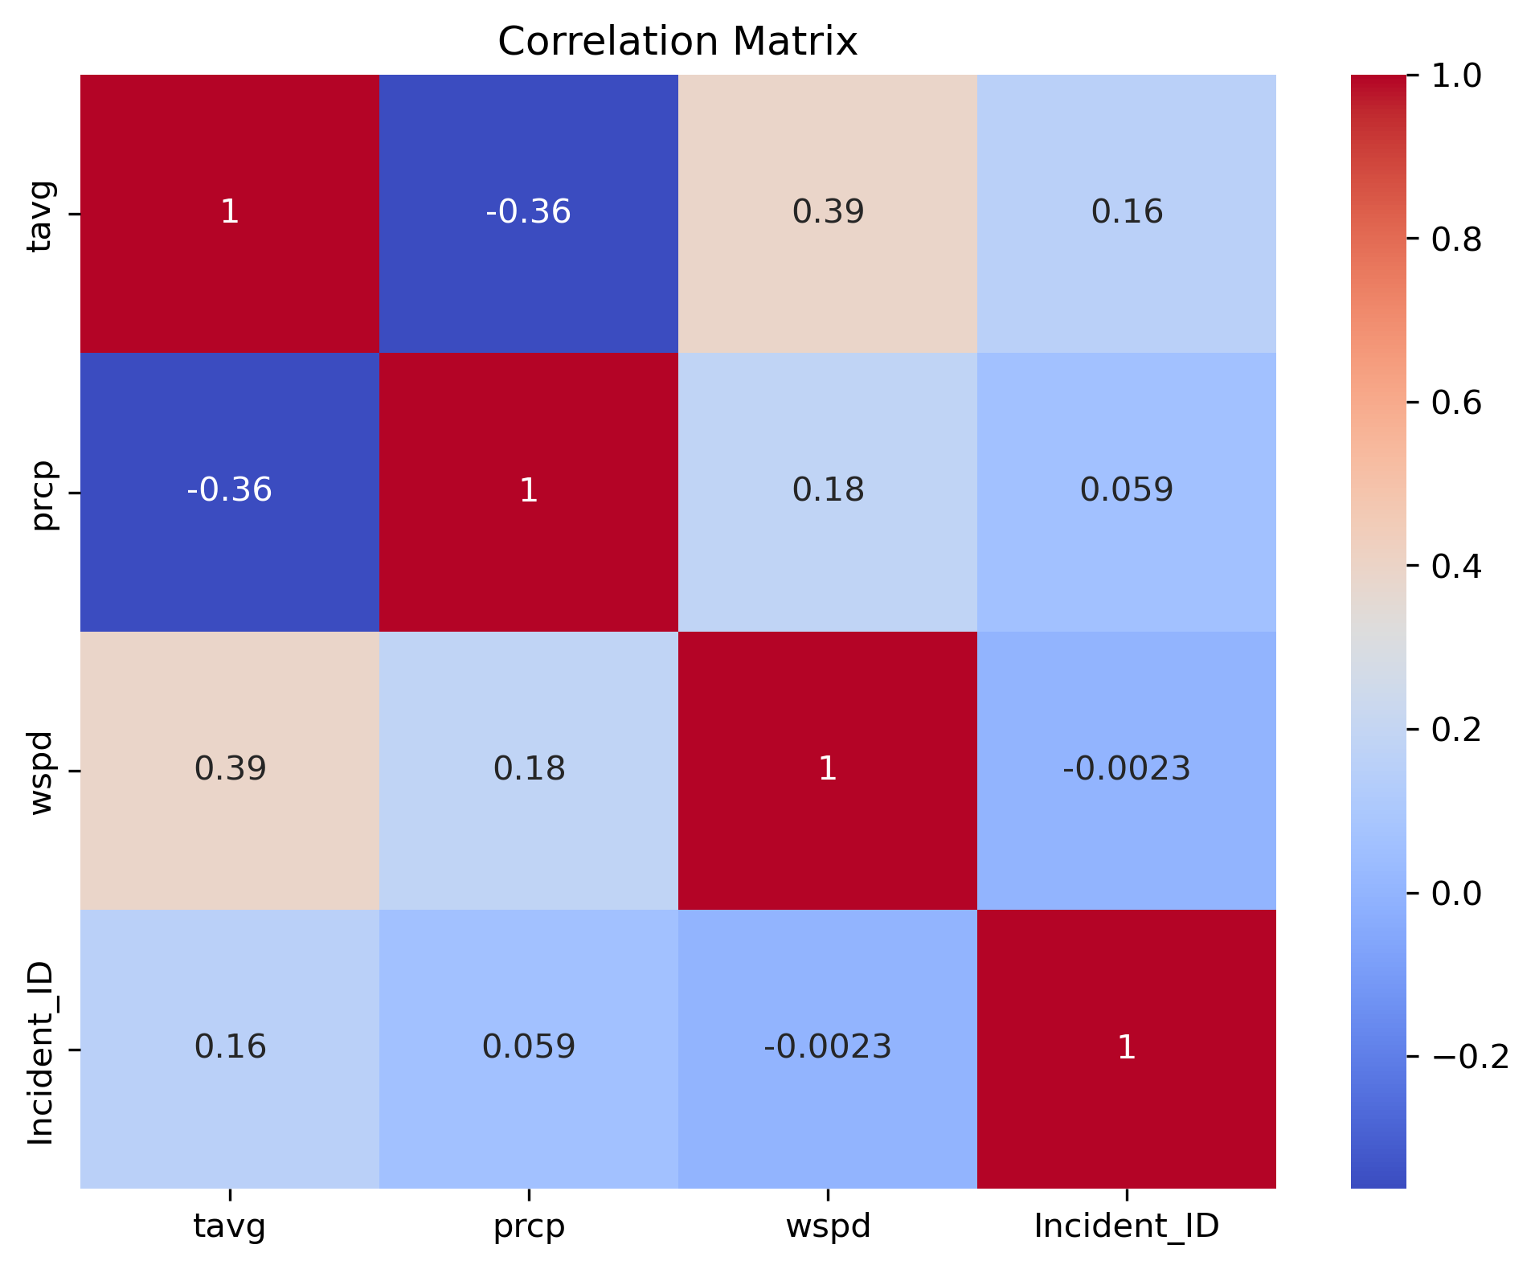
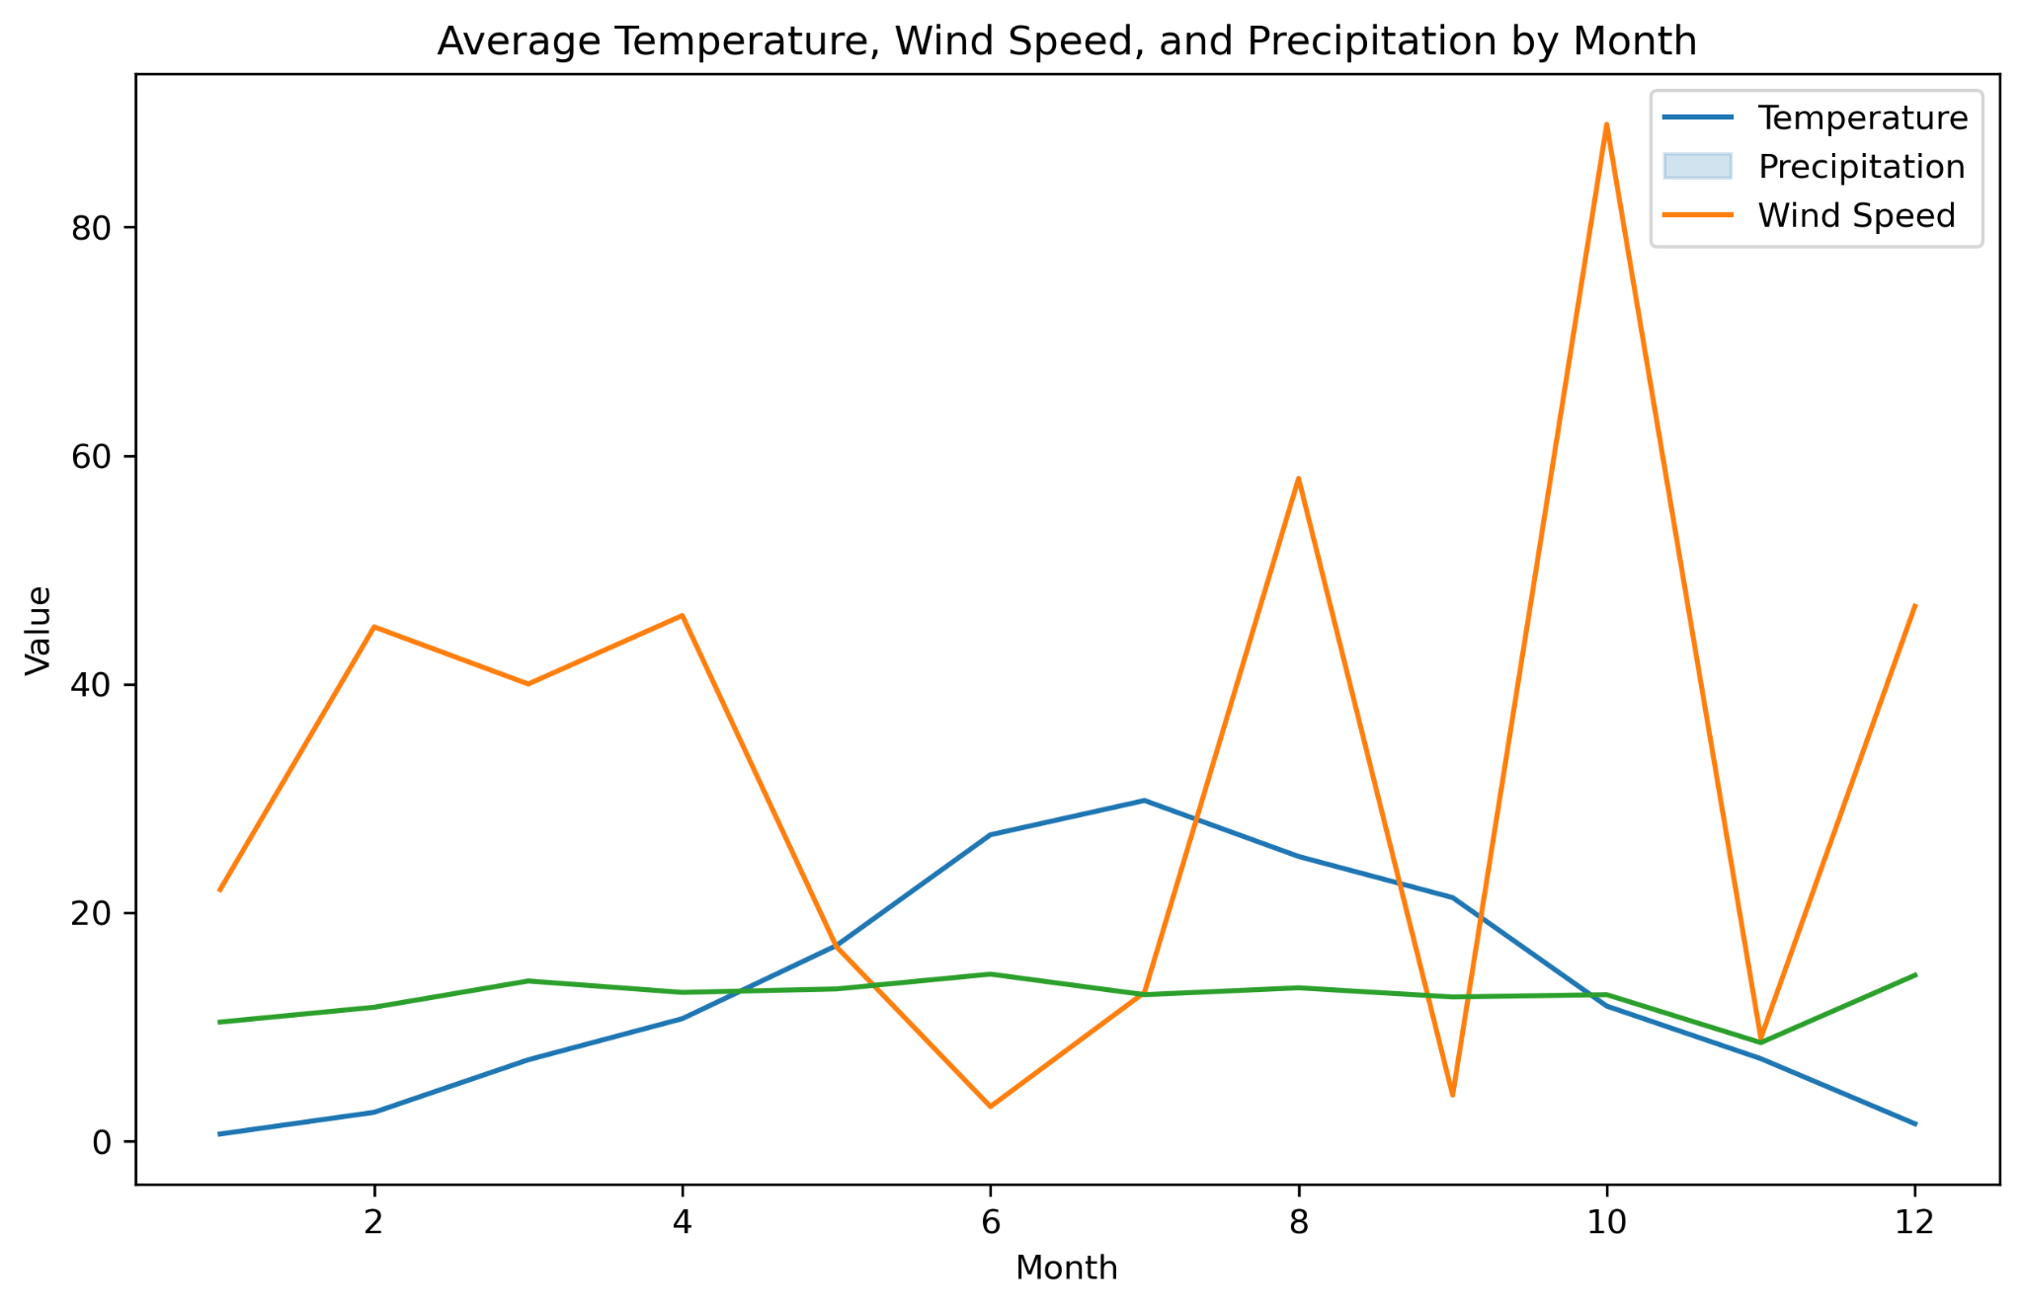
FINDINGS
• Average temperature, wind speed, and precipitation by month were plotted to identify any patterns or correlations between weather conditions and crime rates. However, there were no clear patterns or correlations between weather conditions and crime rates.
• Correlation matrix between variables showed a weak positive correlation between temperature and incident ID.
• Regression analysis showed that temperature had a statistically significant effect on crime rates.

Slide 7
LIMITATIONS
• Study only analyzed crime and weather data from Salt Lake City.
• Findings may not be generalizable to other cities.
• Study did not include other factors that could affect crime rates such as demographics, socioeconomic factors, and policing strategies.

Slide 8
CONCLUSIONS
-What is the impact of weather conditions on crime rates in Salt Lake City?
The analysis in the report on Crime and Weather Data Analysis showed that temperature had a statistically significant effect on crime rates in Salt Lake City, with a one-degree increase in temperature leading to a 0.012 increase in the incident ID. However, other weather variables such as precipitation and wind speed did not have a significant effect on crime rates.
-Does temperature have a statistically significant effect on crime rates in Salt Lake City?
Yes, according to the report on Crime and Weather Data Analysis, temperature has a statistically significant effect on crime rates in Salt Lake City.
-Is there a correlation between crime rates and temperature, precipitation, and wind speed in Salt Lake City?
The report on Crime and Weather Data Analysis discussed the correlation matrix between variables such as temperature, precipitation, wind speed, and incident ID. The analysis found that there was a weak positive correlation between temperature and incident ID, but other weather variables such as precipitation and wind speed did not have a significant correlation with crime rates.
-What recommendations can be made based on the findings of the analysis of crime and weather data in Salt Lake City?
The report on Crime and Weather Data Analysis recommended that law enforcement agencies should allocate more resources during the summer months when crime rates are high. The analysis could also be used to identify areas that need more attention or resources.

Slide 9
Report on Crime and Census Data Analysis
• Goal: Identify patterns or correlations between various demographic features and crime rates in Salt Lake City.
• Two datasets used: crime data from the FBI's UCR program and demographic data from the Census.
• Analysis includes loading, cleaning, merging datasets, and creating six visualizations.
Methodology
• Python programming language and several libraries used, such as pandas, seaborn, matplotlib, and statsmodels.
• Datasets cleaned by converting the date column to datetime format.
• Two datasets merged on the "Group" column.
• Six visualizations created to help understand the data better.

Slide 10
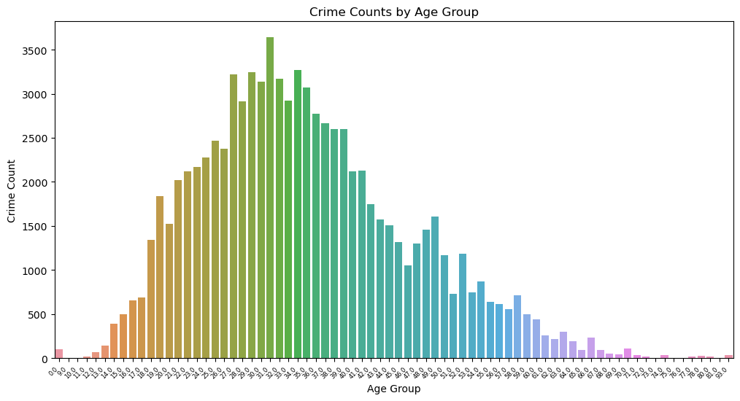
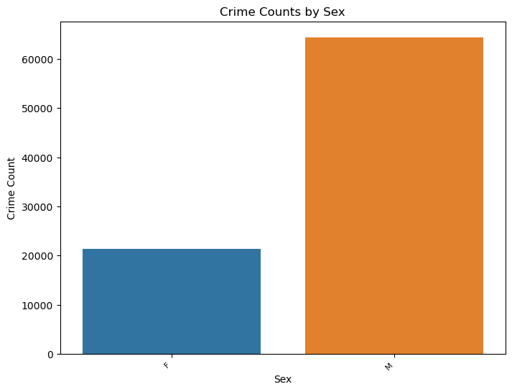
FINDINGS
The analysis found that the mean crime rate for each city in 2021 was as follows:
NORTH SALT LAKE: 7773.67
SALT LAKE CITY: 52861.82
SALT LAKE CNTY UNIFD PD: 3396.26
SOUTH SALT LAKE: 4489.46
The analysis revealed that crime counts were highest in the age group of 18-25, with males having a higher crime rate than females.

Slide 11
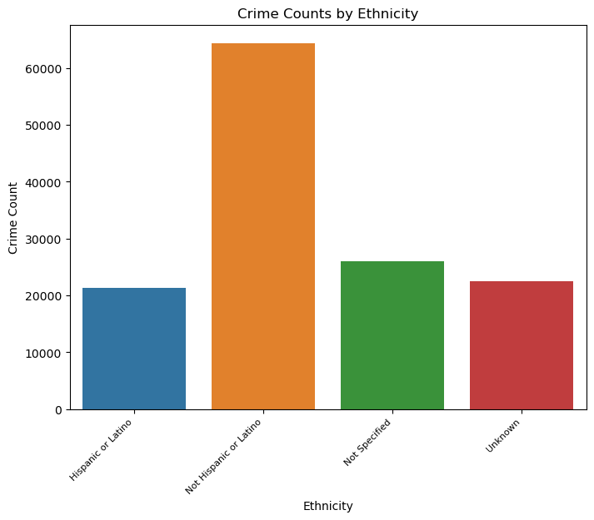
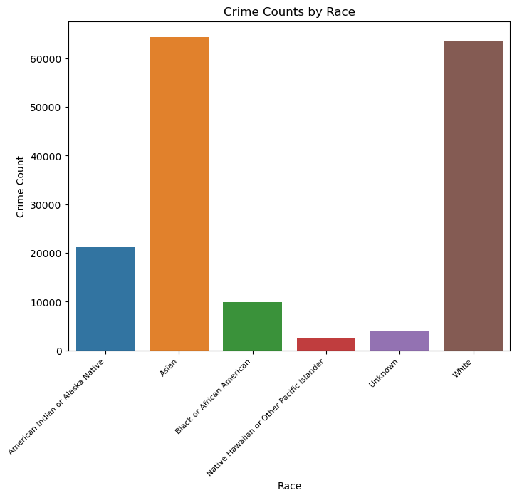
FINDINGS
Crimes were most frequently committed by individuals who identified as White not Hispanic/Latino.

Slide 12
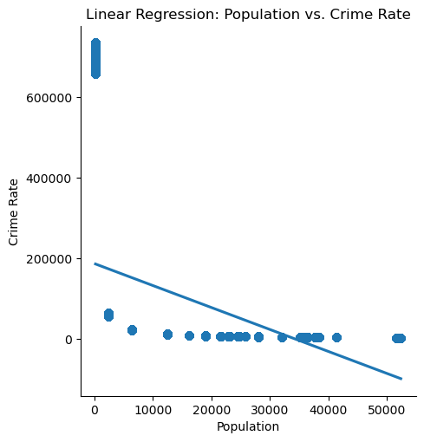
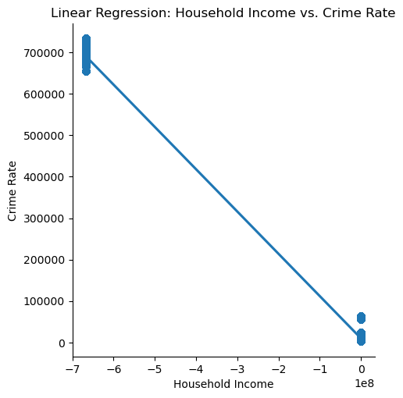
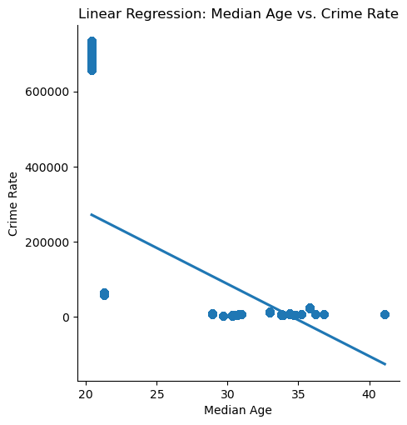
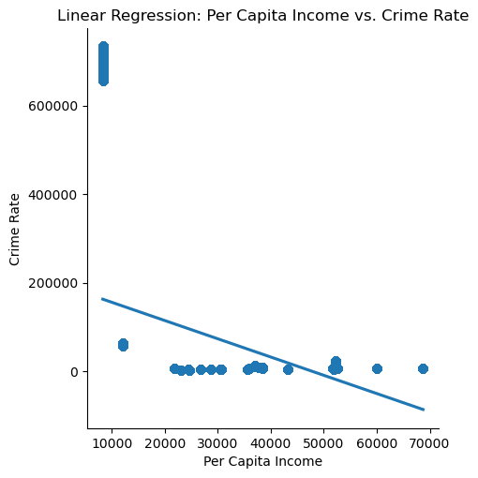
The third plot shows a weak positive relationship between household income and crime rate, meaning that as household income increases, the crime rate tends to increase slightly.
The first plot shows a positive relationship between population and crime rate, indicating that as the population increases, so does the crime rate.
The second plot shows a weak negative relationship between median age and crime rate, meaning that as median age increases, the crime rate tends to decrease slightly.
The fourth plot shows a strong positive relationship between per capita income and crime rate, indicating that as per capita income increases, so does the crime rate

Slide 13
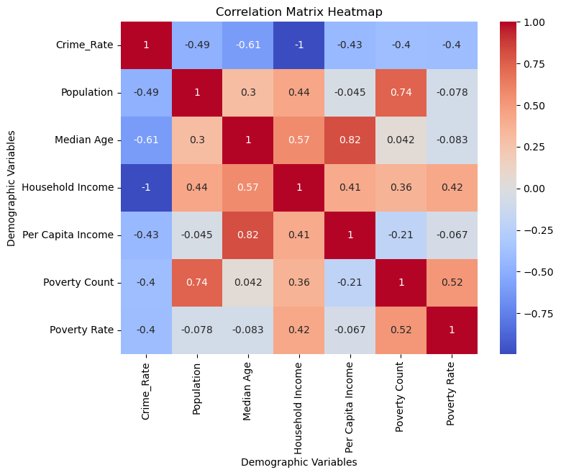
FINDINGS
The heatmap shows strong positive correlations between population and crime rate, and between household income and per capita income. It also shows a weak negative correlation between median age and crime rate. Overall, the analysis shows that the crime rate is strongly related to demographic variables such as population, household income, and per capita income. It also suggests that age and race may play a role in crime rates, although the relationships are weaker.
LIMITATIONS
Analysis only covers data from the year 2021 and may not be representative of broader trends or patterns over time. Other limitations include missing or incomplete data, and potential confounding variables.

Slide 14
CONCLUSIONS
-What is the trend of the crime rate in Salt Lake City?
Based on the report on Crime and Weather Data Analysis, the crime rate trend in Salt Lake City is higher during the summer months and lower during the winter months.
What are the demographic factors that contribute to the variation in crime rates?
-The report on Crime and Census Data Analysis explored the relationship between crime rates and various demographic factors. The analysis found that there were differences in crime rates based on demographic features such as age, sex, race, and ethnicity.
-What are the key factors that contribute to the variation in crime rates in Salt Lake City?
The report on Crime and Census Data Analysis found that there were differences in crime rates based on demographic features such as age, sex, race, and ethnicity.
-How does the crime rate vary with different demographic features such as population and income in Salt Lake City?
The report on Crime and Census Data Analysis found that there was a positive correlation between population, median age, household income, and crime rate. The analysis also created scatter plots to explore the relationships between demographic variables and crime rates.
-How can the findings of crime and census data analysis be applied in law enforcement agencies to allocate resources effectively in Salt Lake City?
The report on Crime and Census Data Analysis recommended that law enforcement agencies should consider demographic factors such as age, sex, race, and ethnicity when allocating resources. The analysis could also be used to identify areas that need more attention or resources based on these factors.

Slide 15
THANK YOU
Q&A

